Slide 1
What does a digital workplace feel like?
Hillary Hartley
Deputy Minister of Consumer Services & Chief Digital Officer

Slide 2
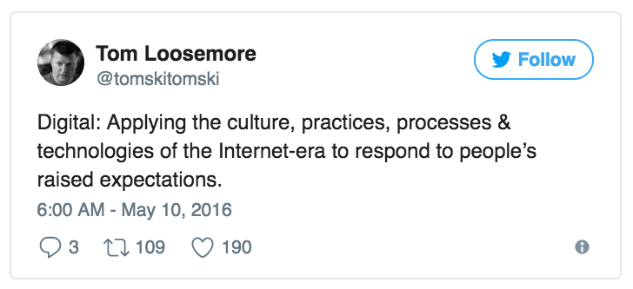
Transforming government in a digital age

Slide 3

Government can be simple, beautiful and easy to use.
-

Slide 4
Digital government in a digital age is about the user.
Good
Notes:
Digital government is user-centred, empathetic service design and delivery.

Slide 5
transform government
government
government
people’s
services
practices
culture
lives
Transforming government in a digital age
Notes:
Digital transformation involves re-orienting the organization towards people-centred practices that deliver better service to Ontarians and restore trust in government.

Slide 6
Leadership is action, not position.
– Donald H. McGannon

Slide 7
DESIGN FOR DELIVERY_
Content
Chief Digital Officer + Deputy Minister Responsible for Digital Government
Digital Enterprise
Experience Design
GOVERNANCE
Engagement
Policy
FRONT OFFICE
SMT+
CHAPTERS
BUSINESS
Operations
Product
People Board
Talent
Technology
Business

Slide 8
Digital isn’t a list of things to do. It’s about how you think, how you behave and what drives decisions in your organization.
– Janet Hughes, Doteveryone

Slide 9
The strategy is delivery.
The culture is delivery.

Slide 10
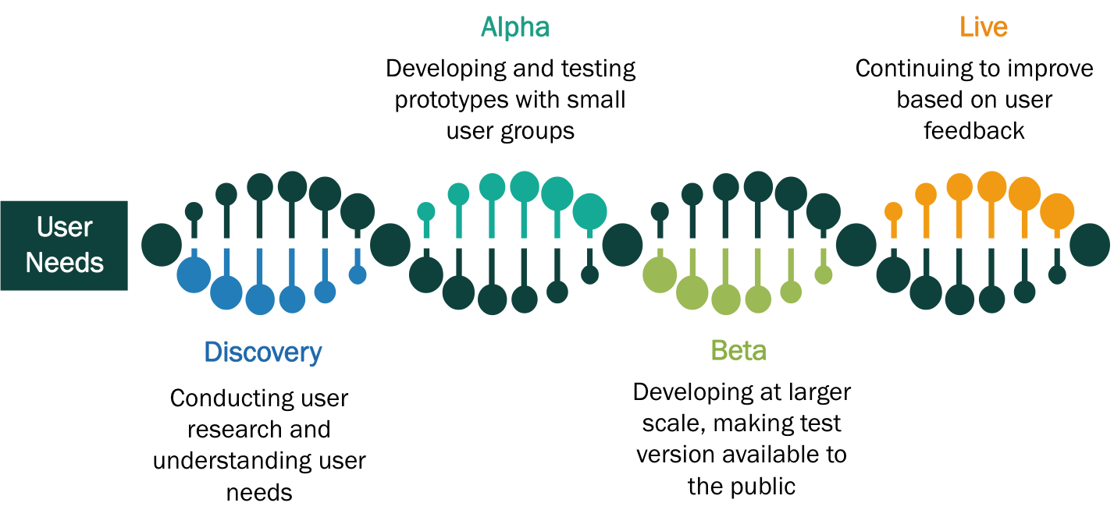
Empowering and enabling agile delivery
Design and build approach
Shorter cycles and better tested services delivered quicker
Continuously improved real-world programs and services rather than paper policies

Slide 11
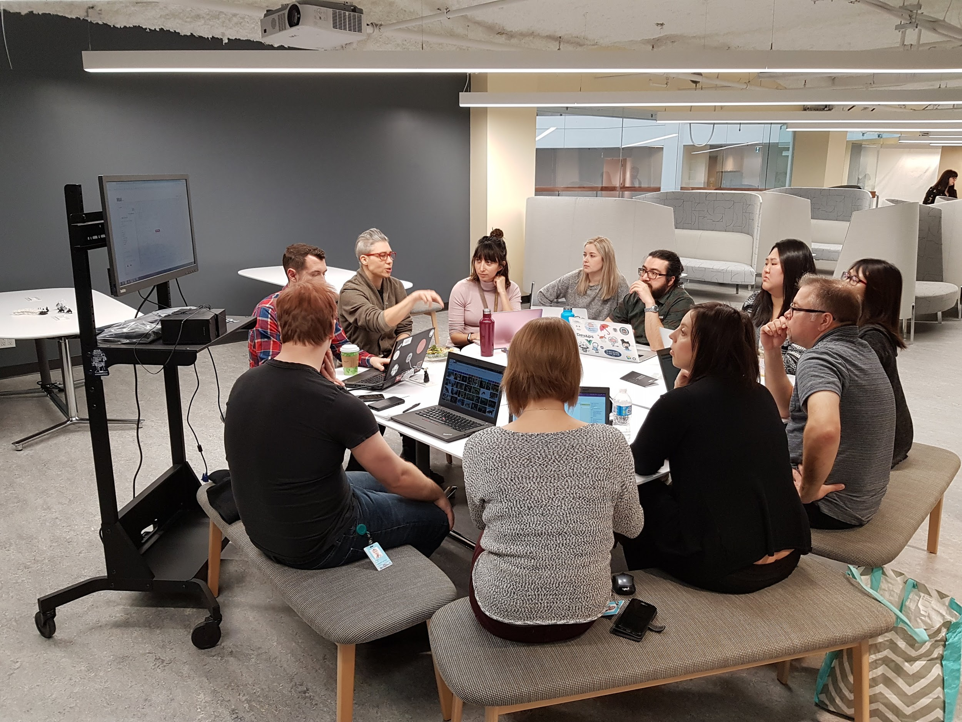
minimum
viable
everythings.

Slide 12
With a focus on service as opposed to hierarchy, organizations can be more responsive to the needs of its people, and more efficient in the delivery of products and programs.
Leadership as Service

Slide 13
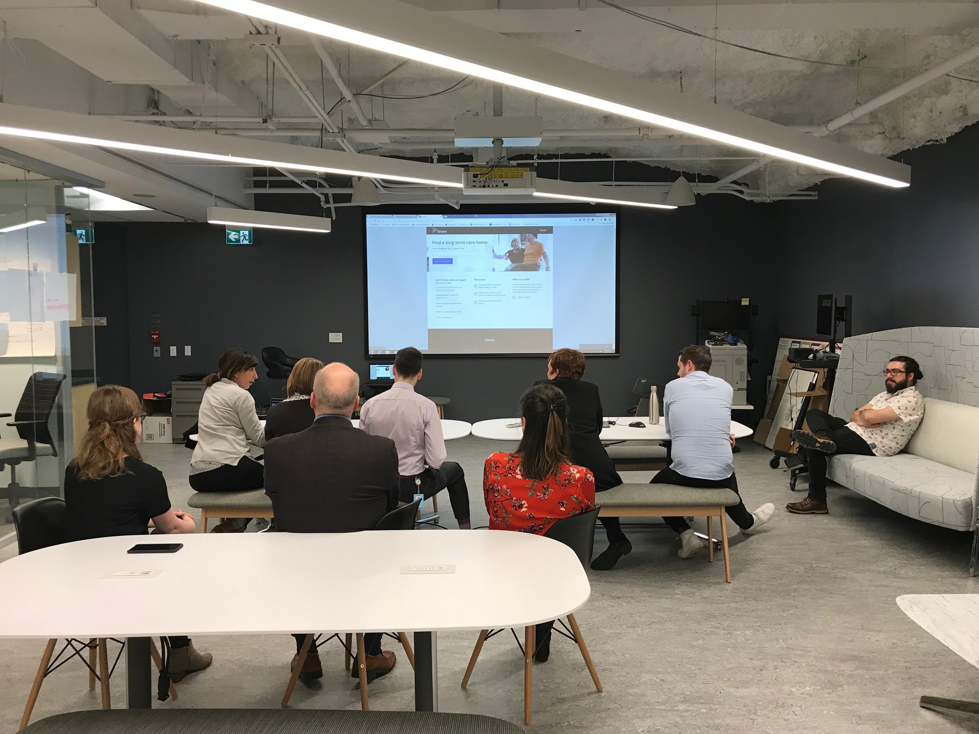
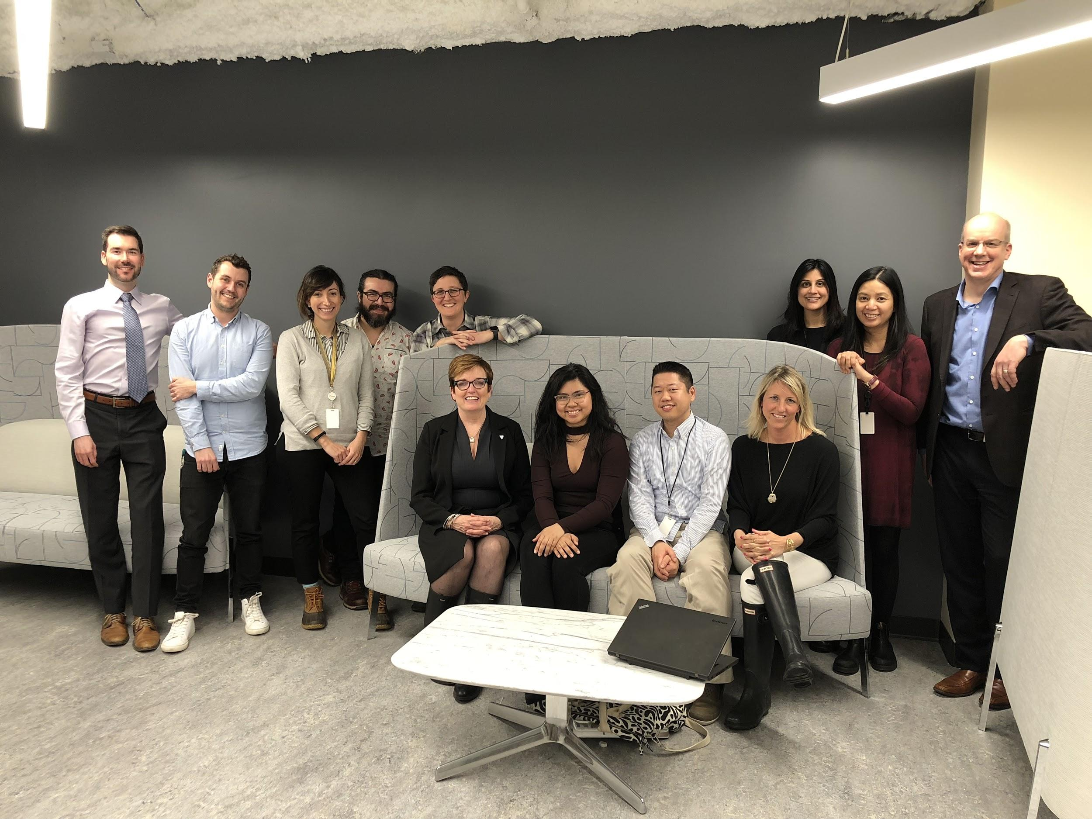

Slide 14
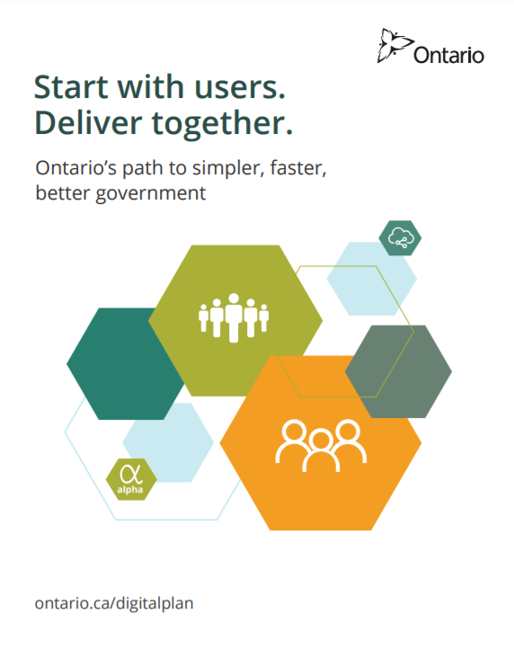
Pillars of the path
Digital Action Plan
People-centred design
Fostering a digital economy
Inclusion, equity and access
Government as a platform
Public service of the future
ontario.ca/digitalplan

Slide 15
Resources
Our blog
The Digital Service Standards
The Service Design Playbook
The User Research Guide
Our team (on Twitter)
People Board blog post (GDS, UK)
Janet Hughes, “What a digital organization looks like”

